Slide 1

CIS 403
CAPSTONE
Jerry Mai

Slide 2

CONTENTS
1
2
3
SDLC
Jira Usage
Design Algorithm
4
5
Product Showcase
Thank You

Slide 3

SDLC
Planning
Analysis
Design
Break down the functionality needed, such as password length, character set, and user intaction
Define the purpose and scope of the password generator
Personal use so it didn’t need any aesthetics
Implementation
Testing & Integration
Maintenance
Readability, error handing, input validation and maintainability in the code
Make sure the password displayed as based off of requirement and identify any bugs that may arise
Since it is for personal use, there is no need for maintenance unless you want to change password requirements

Slide 4

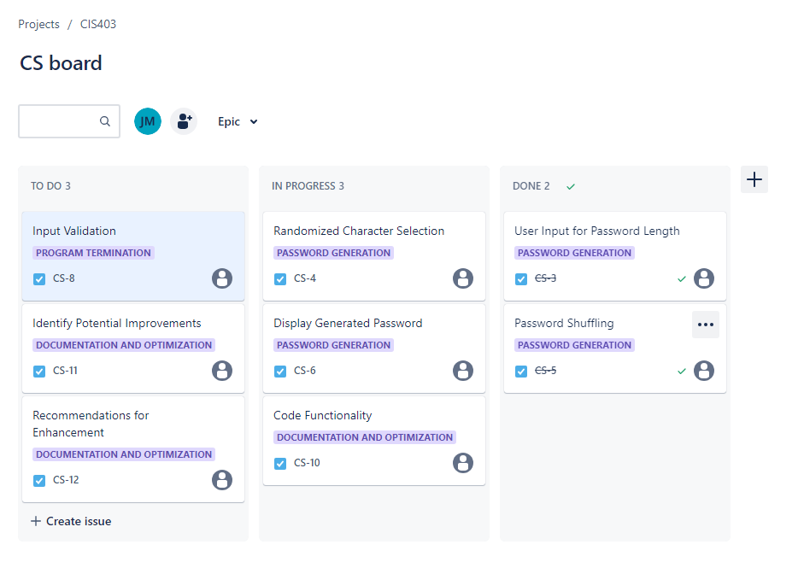
Jira Usage

Slide 5

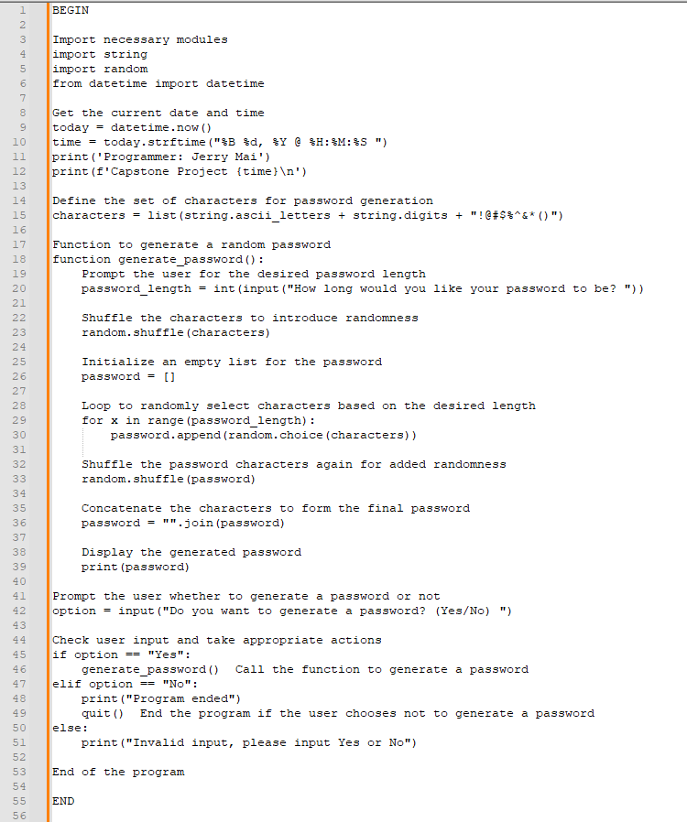
Design Algorithm

Slide 6

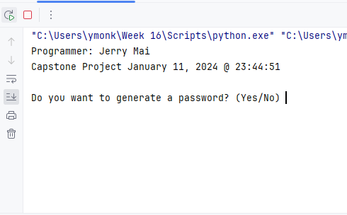
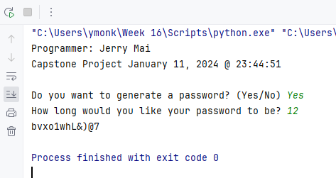
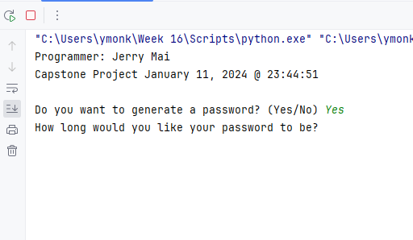
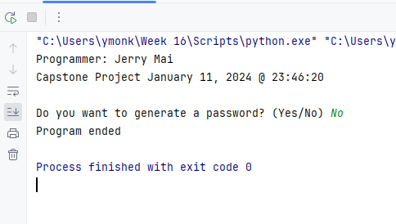
Product Showcase

Slide 7



Jerry Mai Jmai@nyc.yearup.org
THANK YOU!
LinkedIn
GitHub

